Slide 1
Rock creek elementary parent teacher club
2022-2023 Year End Review

Slide 2
2022-2023 PTC Objectives
Bring the Community Back Together.... In Person!
Reignite School Wide Assemblies + Field Trips
All Events FREE of charge
We also....
Created a Technology Plan and Began Implementation

Slide 3
Board Meeting Dates for 2022-2023 Public Board Meeting Dates 2022-2023
Meeting Dates Meeting Dates
08.12.2022 09.22.2022
09.12.2022 10.26.2022
10.10.2022 11.16.2022
11.14.2022 12.14.2022
12.12.2022 01.27.2023
01.11.2023 02.15.2023
02.10.2023 03.15.2023
03.13.2023 04.19.2023
04.06.2023 05.17.2023
05.08.2023 06.14.2023
06.12.2023
Notes:
Secretary Dates of Meetings and Minutes

Slide 4
volunteers
422
Approved volunteers for Rock Creek Elementary
16,000
Individual Logins. Tens of thousand of hours logged
Learnings from the year:
Sending a single event focused reminder email 3-7 days before the event yielded the best sign ups
More specifications in descriptions such as limitations, and where to meet is helpful
Have volunteer opportunities pre-loaded in Better Impact at the start of the year

Slide 5
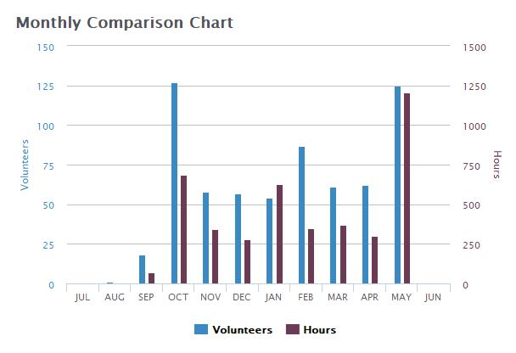
by month: Volunteers + hours
Big spikes for Rocket Run, Class parties, Zoo Field trip and the Carnaval

Slide 6
Rocket Run
2022 Event Details:
Principal’s challenge , 6 laps
5128 Laps, 512.8 miles
Why do we do it?
This is our Primary Fundraiser for the PTC. This provides Field trips, Assemblies, Appreciation week, school snacks and events like Dances and the Carnival for the Rock Creek School Community.
Financial Result:
Goal: $30,000
Bonus: $33,000 - Water Bottle award unlocked!
Actual: $36,599.49

Slide 7
Passive fundraising $12K
Passive Fundraising
Interest | $ 2.97
Benevity | $ 447.50
Amazon | $ 502.34
Kroger | $ 214.78
Papa Murphy | $ 2,361.70
CAF | $ 1,101.46
Daimler Trucks | $ 100.00
PayPal Giving | $ 520.61
America Online | $ 2,680.89
McDonald's | $ 1,292.90
Piccolo Mondo | $ 134.62
Bottle Drop | $ 125.00
Brighten | $ 70.00
Krispy Kreme | $ 178.48
McMenamins | $ 2,419.38
Box Tops | $ 22.50
Total | $ 12,175.13

Slide 8
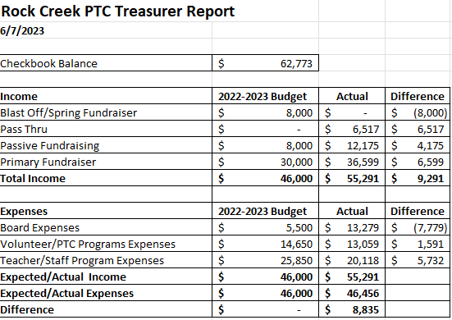
Financials *PTC books close June 21, final financial will be available in august

Slide 9
Events
Art Literacy
School Supply Drop Off
Fall Dance
Movie Night
Spring Dance
Spring Carnival
Staff Apprec-iation
School Day Campus Events

Slide 10
School Day Enrichment + Fun at Rock Creek
PTC Sponsored Campus Events + Enrichment benefiting students!
Annual Art Lit Program and Supplies
4 Projects for all Classrooms
Field Trips
Kinder and 1st In-Class Visits with OMSI
2nd OMSI Field Trip
3rd Hops Game Field Trip
4th Oregon Historical Society
5th Bowling Events
All school to Oregon Zoo + Frozen the Musical, PTC provided snacks
3 Assemblies
Rocket Run Kick-Off
OMSI React-O-Blast
Science Circus
Fall and Friendship Class Parties
5th Grade Send-Off
June 16th Field Day
To include lawn games, face painting, magician and popsicles!

Slide 11
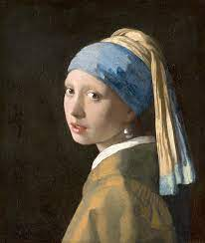
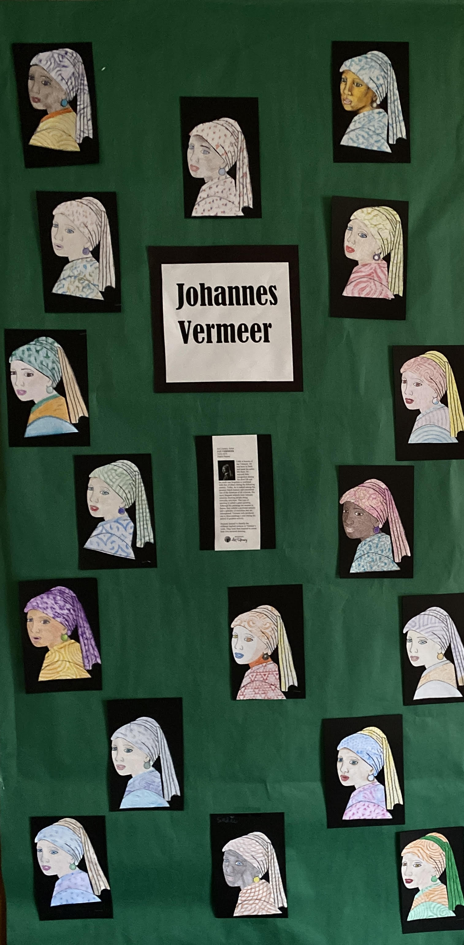
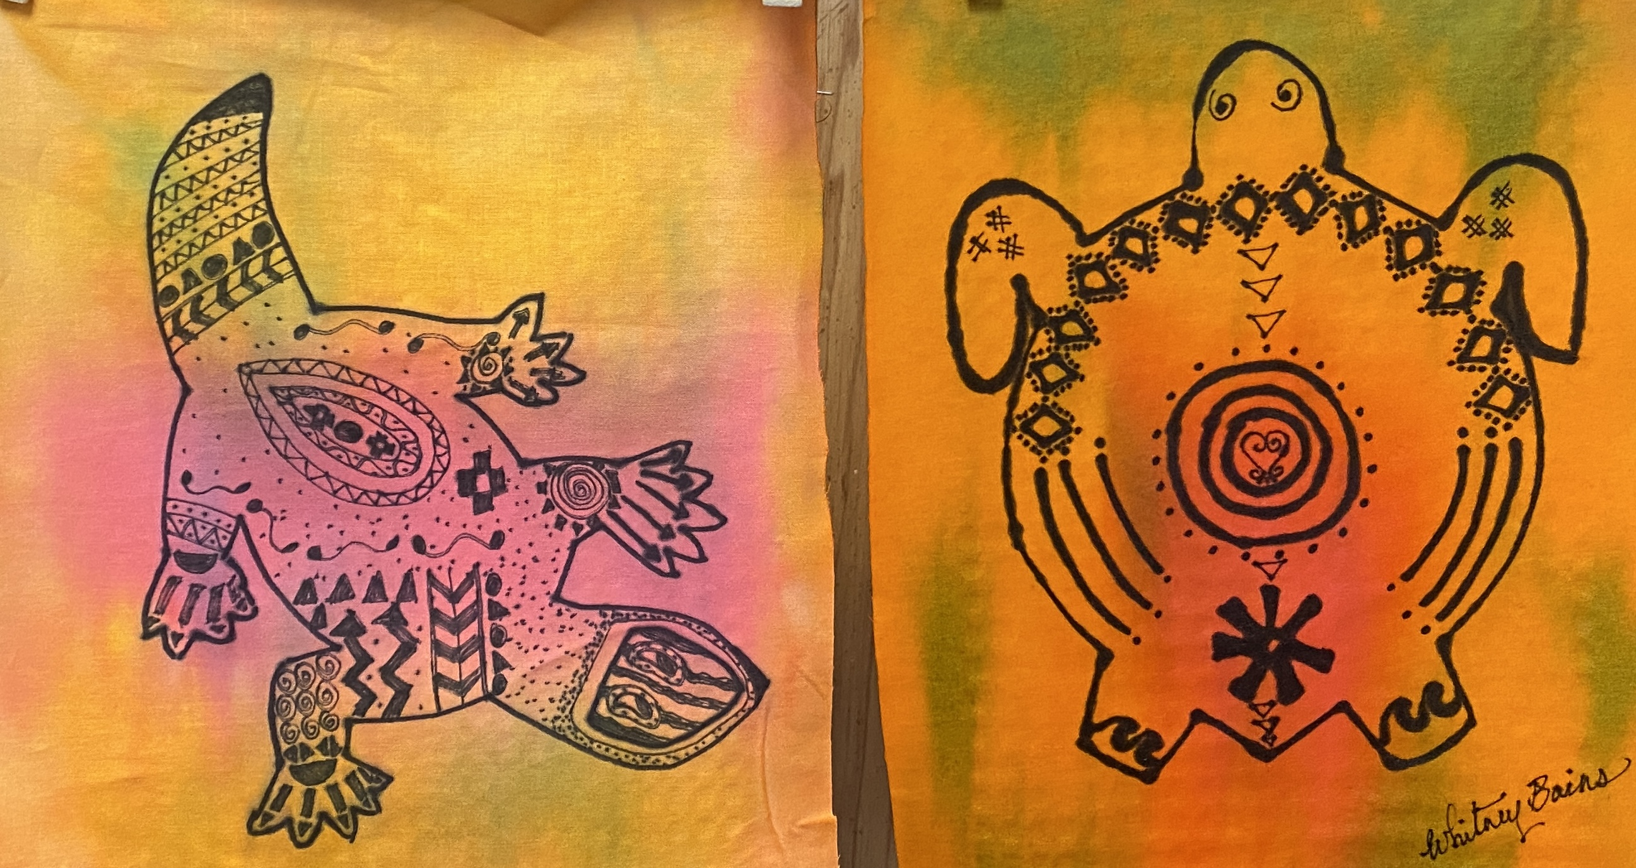
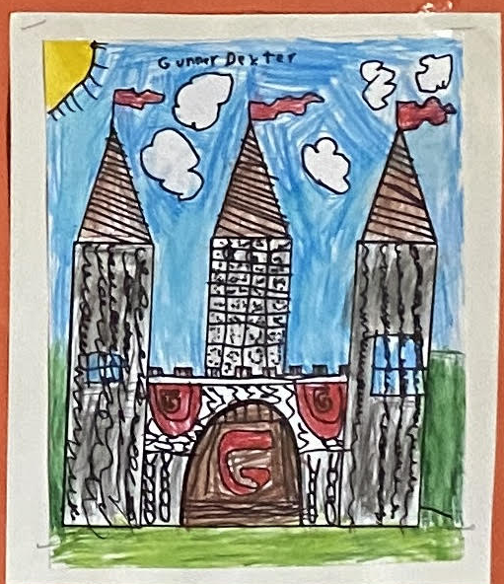
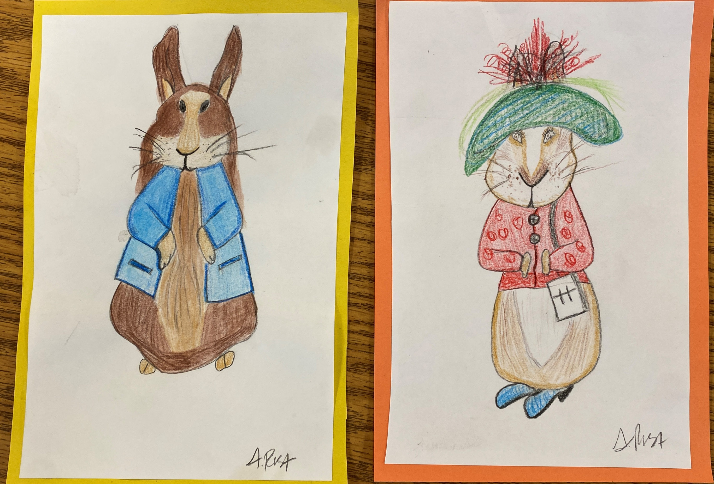
Art Lit 2022-2023
Focus: Line and texture in art.
Featured Artists: Johannes Vermeer, Maxfield Parrish and Beatrix Potter
Culture: Western African Textiles

Slide 12
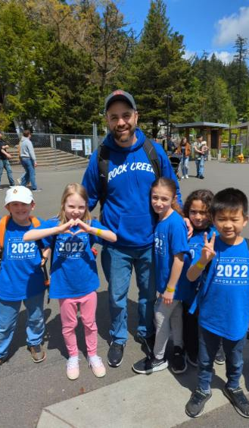
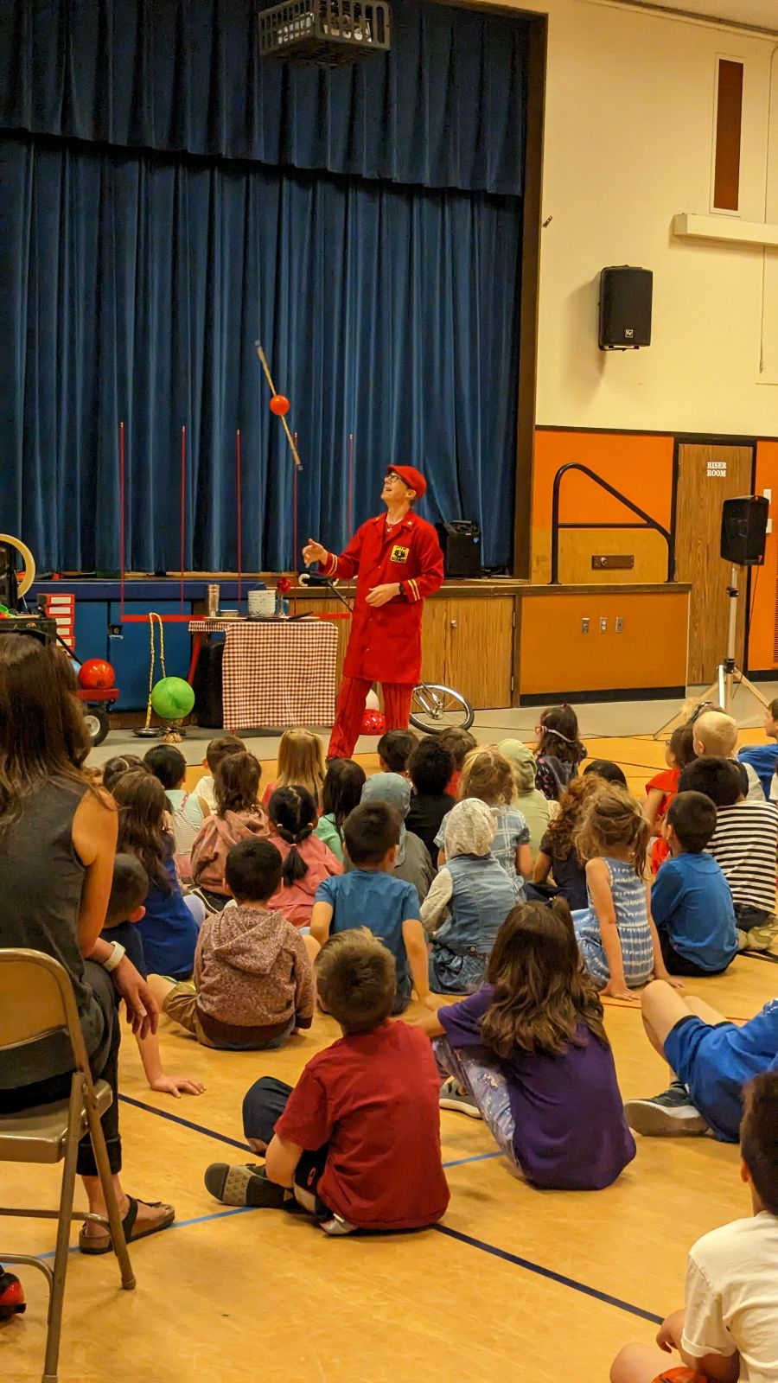
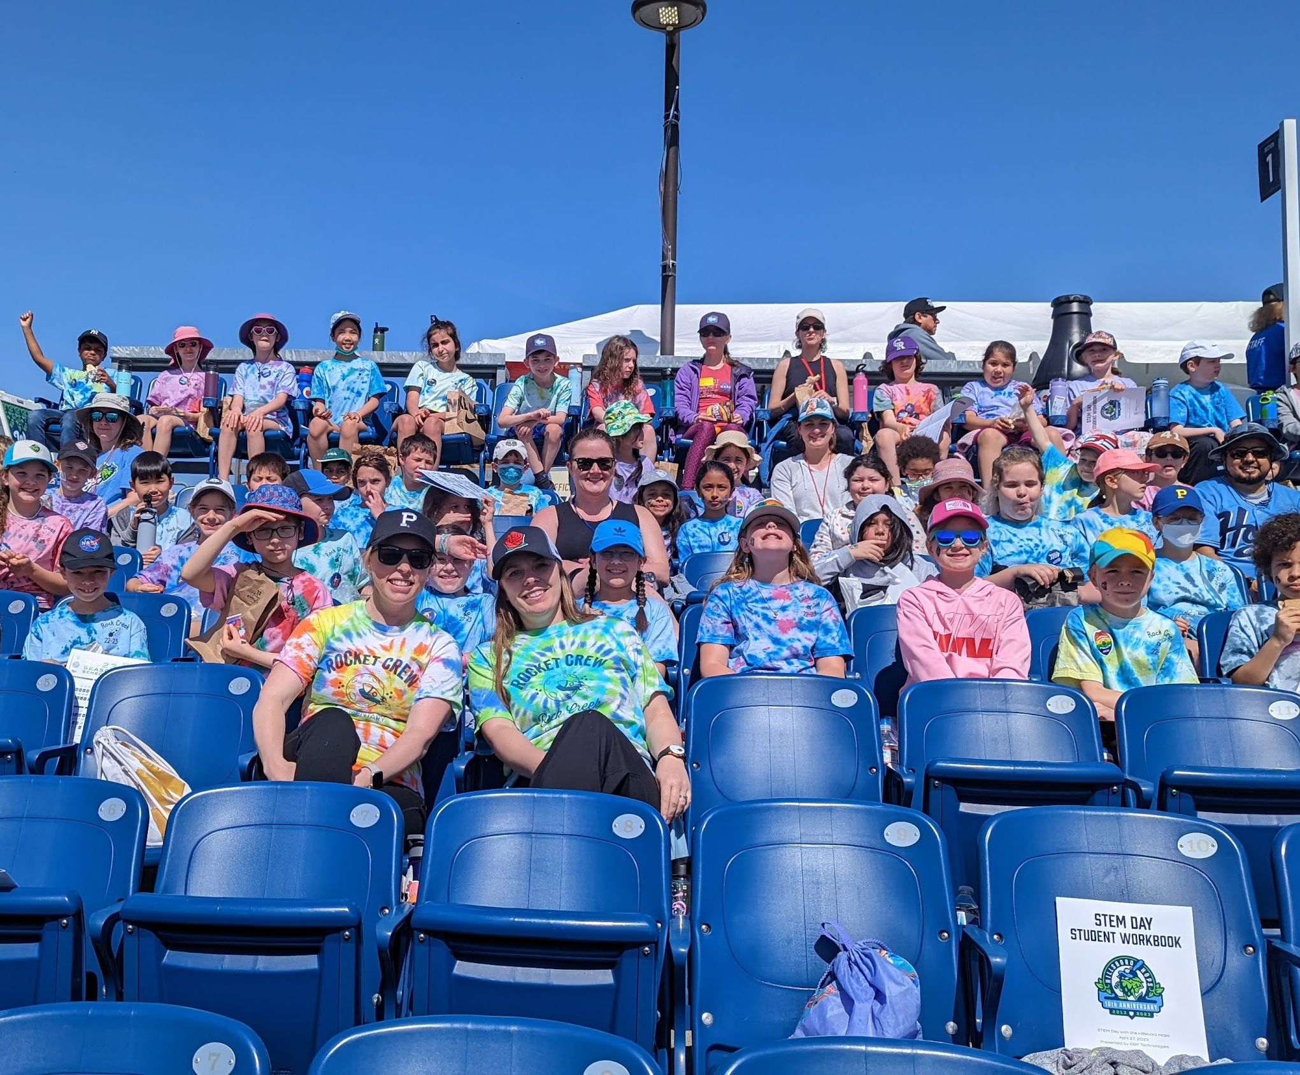
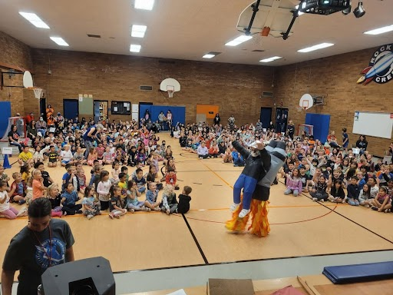

Slide 13
PTC Communications
ParentSquare: 40 posts
Social Media (Facebook + Instagram): 138 posts
Utilized to highlight PTC activities, fundraisers, volunteer opportunities, and PTC-sponsored school events
During the 2022-2023 school year: FB reach ~3400, IG reach 131
Increased FB page visits (481 current followers), IG visits and followers (121 currently) over previous year

Slide 14
PTC Communications
Logo design/other visual media:
Updated Rock Creek PTC Bulletin Board
Created Flyers (e.g., Fall Dance, Spring Dance, Spring Carnival, Kindergarten Orientation, Staff Appreciation)
Designed Logos for Rocket Run water bottles, 5th grade letterhead, Kindergarten Orientation t-shirt, Rock Creek Fun Run bag logo, and Staff Appreciation t-shirt logo

Slide 15
Looking Ahead + taking action
Board Transition + On-Boarding
‘23-’24 Calendar + Balanced Budget
Summer Break for the Board!
July - Mid August

Slide 16
Thank You
1st VP
JP
Zbylut
2st VP*
Sakina Abdul
Treasurer*
Jaime
Khu
Secretary*
Becky
Erion
Thank You
Communications
Alison Toshima
Communications
Beth Keebler
Volunteer
Allison Pedersen
Past President
Chanel Sheragy
Thank You
David Westhora + Jessica Vogel + Arron Hanson
2022-2023 PTC President: Marianthe Tufts

Slide 17
Johannes Vermeer
The girl with the Pearl Earing
Creating lines with texture plates
Students create their own “girl with the pearl earing” using texture plates, crayons, and colored pencils.

Slide 18
Maxfield Parrish
Creating a fairytale scene
Used illustrations from Parrish’s books as an example.
Told stories and discussed his work as an illustrator and artist.
Sharpies and colored pencils
Castle was the most popular
Students were able to choose from a variety of castle designs.

Slide 19
Beatrix Potter
Drawing Peter Rabbit
Watercolor Pens
Used watercolor pencils to sketch
Finished using water pens to activate the color and create a finished look much like Potter’s famous Peter Rabbit stories.
Each student ended up creating their own rabbit style.

Slide 20
Western African Textiles
Creating a story on fabric
Liquid watercolor and sharpies
Used stencils and African symbol sheets to create a design that has hidden meanings.
Students created their own personal design and had the option to create a class banner.
Used liquid watercolor and gold spray overlay to finish.
Created texture by allowing the fabric to semi-dry in Styrofoam trays.

